Slide 1


Smart Beach at Bruce County
Sanjeev Kumar - Professor
Brunilda Xhaferllari – Project Manager
Rich Freeman – Faculty Mentor
AI Team:
Janvi Patel
Fangji Chen
Scaria Ouseph Kurian
Notes:
Image: Sunrise Over Beach in Cancun Stock Image - Image of sunrise, beach: 40065727 (dreamstime.com)

Slide 2
Content
Project Summary.
Project timeline chart.
Model selection for Crowd counting.
Results of crowd-counting models.
Issues faced with Crowd counting.
Re-routing the method And Deciding on a final model design.
Image classification models.
Model options for image classification.
Testing the models for the data.

Slide 3
Architecture improvement

Slide 4
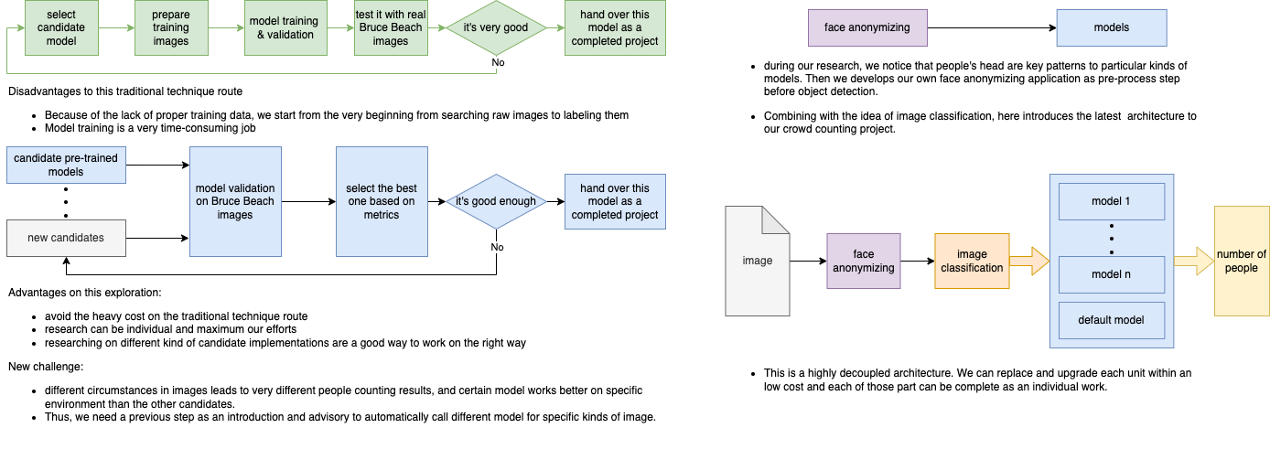

Slide 6
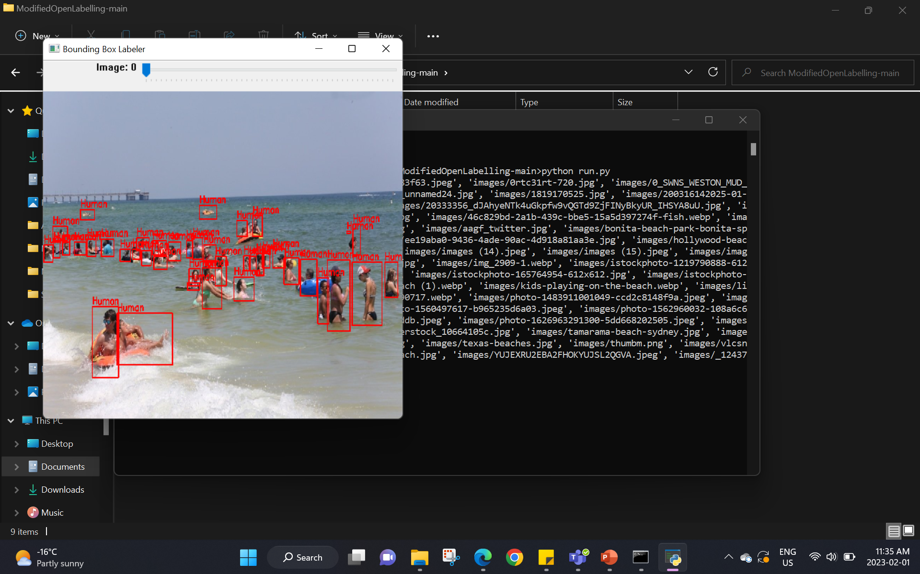
Model selection for Crowd counting
After all the research we found some potential models to identify the exact number of people in the picture.
The algorithms work well in different scenarios for which trying each one of them is the only option to discover the characteristics that particular algorithm will perform best.
There are some potential object detection models that we are working with.
YOLOv8
ResNet
InsightFace
The very first step for applying all these models was to label the images. We have used a bounding box labeler for that.
Mark(2020.5)

Slide 7
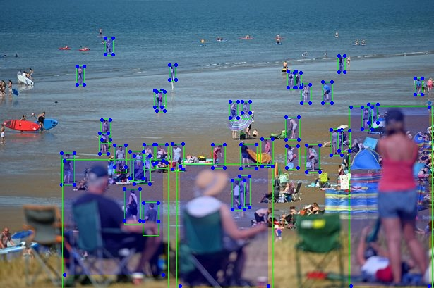
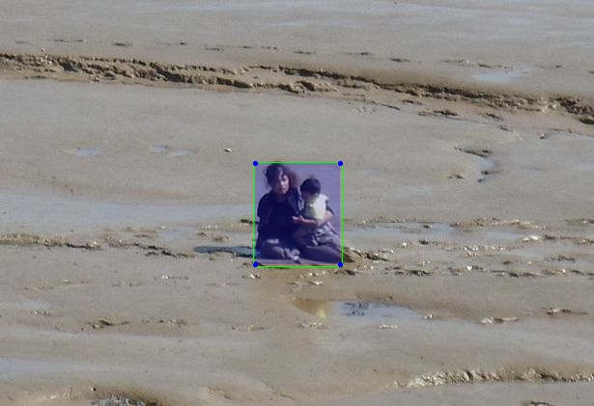
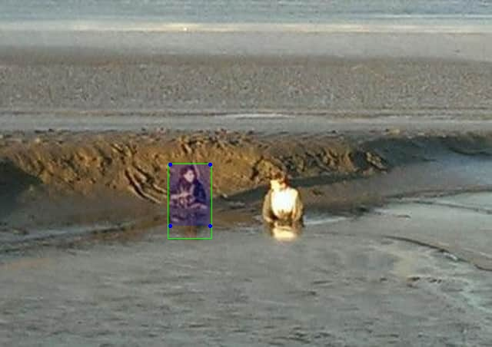
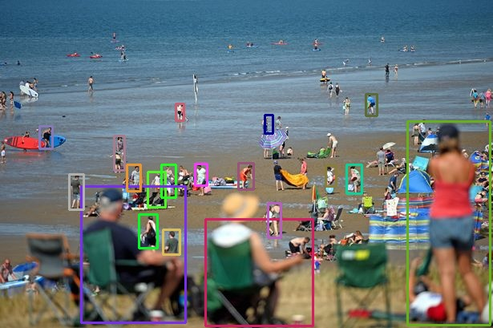
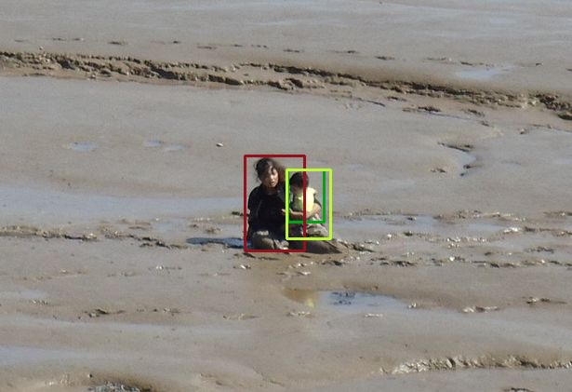
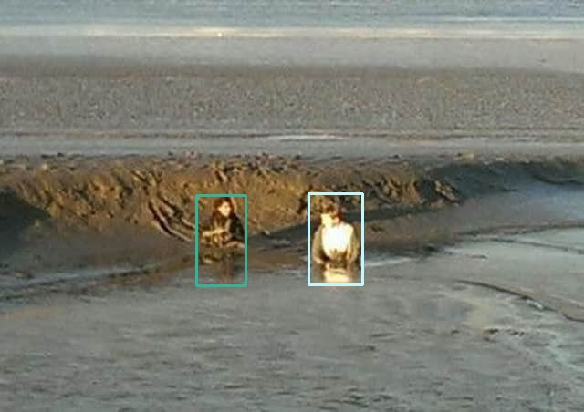
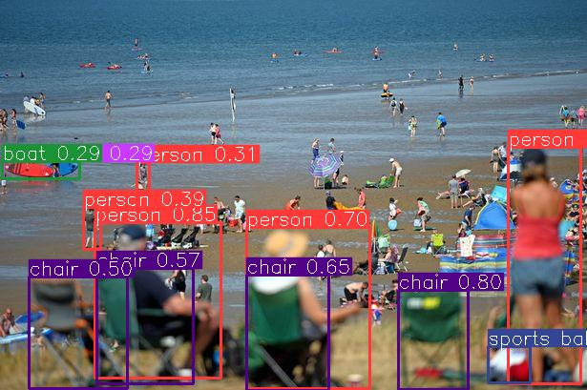
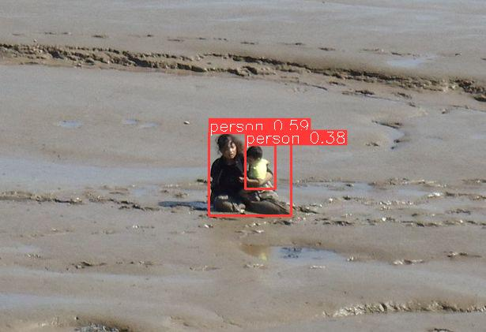
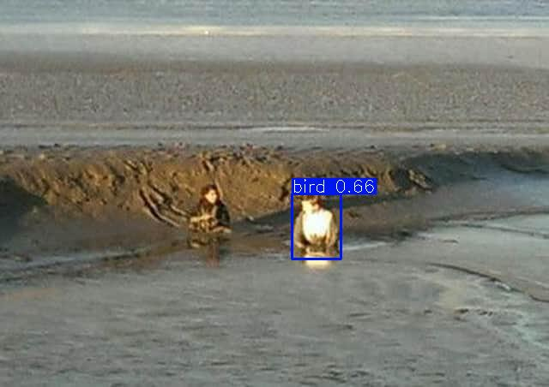
Results of crowd-counting models.
1
3
2
Insightface
Resnet
YOLOv8
2
2
1
3
1
3
Nick(2020.6)
Getty(n.d.)

Slide 8
Technical difficulties with crowd-counting algorithms
As we can see in the above slide all three algorithms work in different situations and parameters of the images.
With the people far from the camera InsightFace model works better.
Whereas, in the second case the picture is not so far from the camera but the objects are overlapping. In this case, YOLOv8 seems to be detected better.
In The last case, Objects brighter on them and for that reason, YOLOv8 has detected the person as a bird which clearly is a fault in object detection. Whereas Resnet seems to be performing better with lower-quality images.
Because of this, we introduce our latest architecture:

Slide 9
Latest architecture

Slide 10
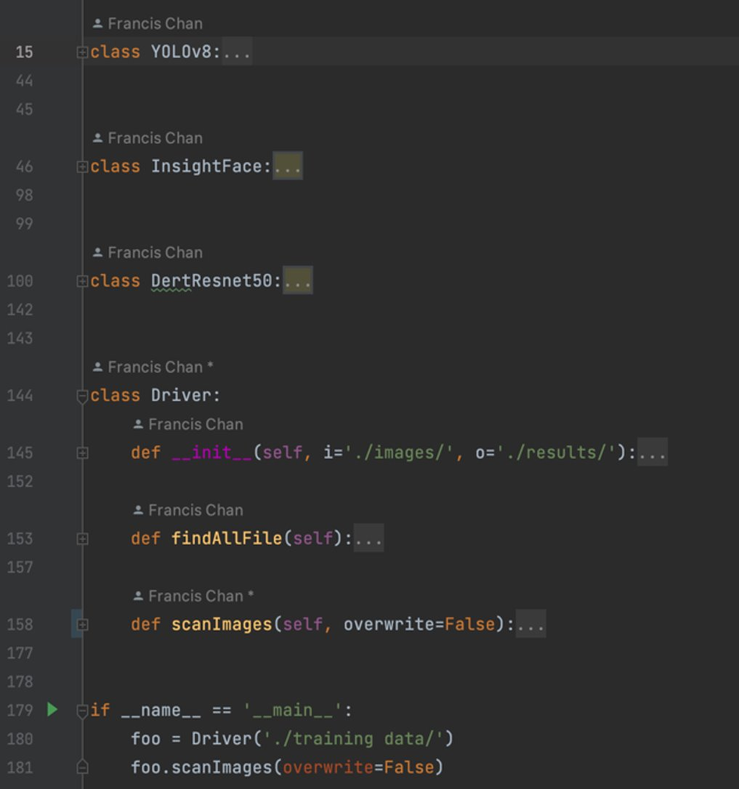
Crowd counting
Prepare validation images
This baseline is going to be used to measure how well our YOLOv8 model performs compares to those pre-trained models.
Prepare development environments for these baseline models
Run baseline models and analyze the results for good cases and bad cases

Slide 11
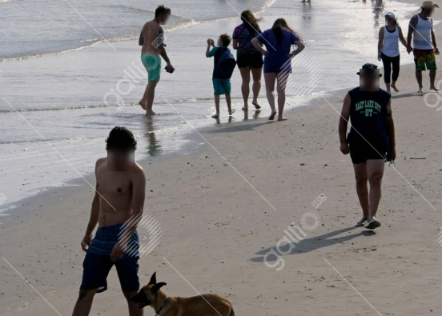
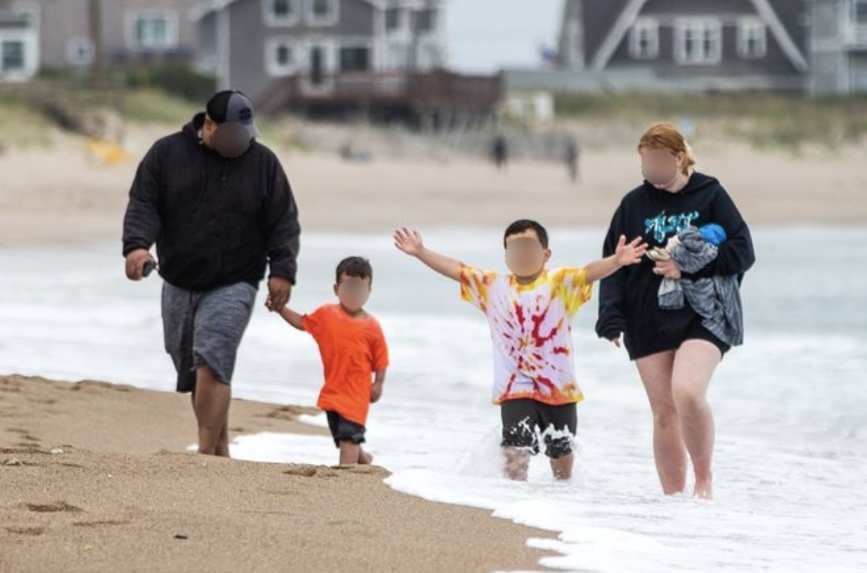
Face Anonymizing
Gallio
software for face anonymizing
GitCode developed by us
https://github.com/franciszero/csp.pytorch
Dawlish(n.d.)
unknown(2014)

Slide 12
Image classification
Main purpose of Image classification is for crowd density and camera angle.
Some of the models that work best for crowd density are:
CSRNet.
DenseNet.
R-CNN.
All these algorithms work in different situations same as for crowd counting.
CSRNet is the short form of Convolution Neural network that uses feature extraction for crowd density classification.
DenseNet is specialized for image classification tasks.
R-CNN Region-Based Convolution Neural Network, the major benefit of which can be classified based on region segmentation.
All these models are trained on the dataset for this specific project to classify the images.
The classification, for now, is done in 3 classes.
One, in which people can be identified clearly.
Second, in which the images are not too crowded or the camera distance is not so far.
Third, in which images are more crowded and the distance is far (forming a cluster).

Slide 13
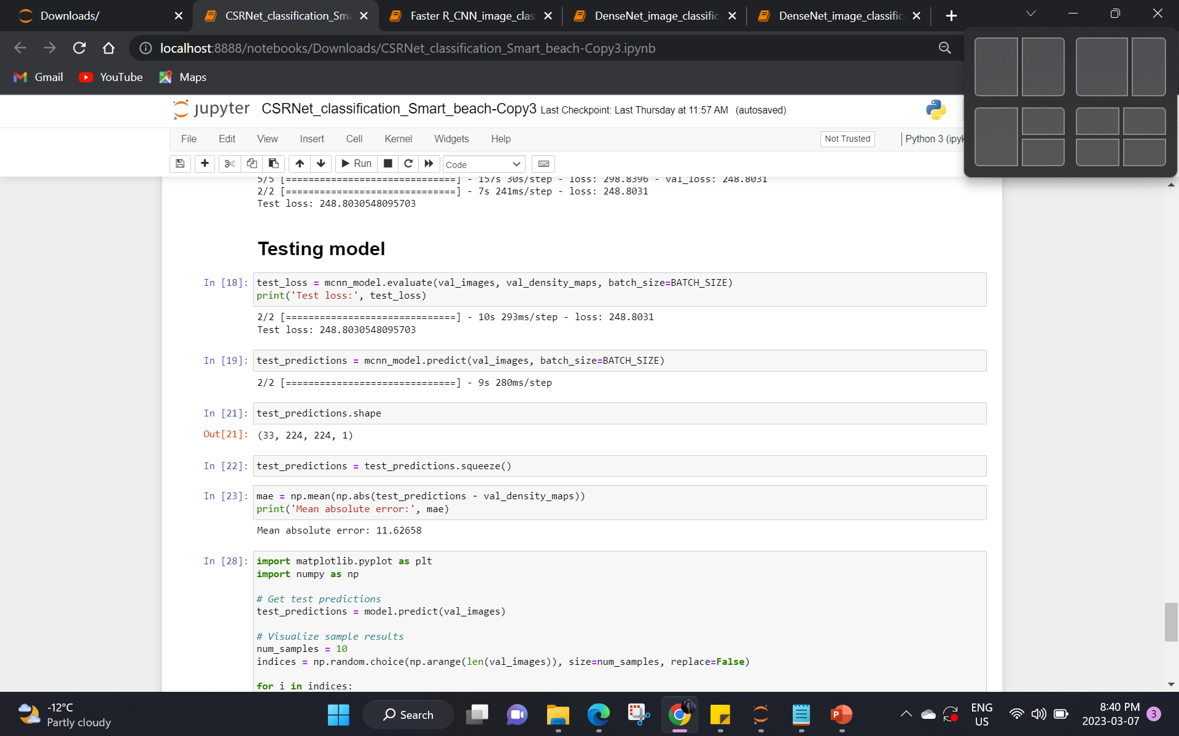
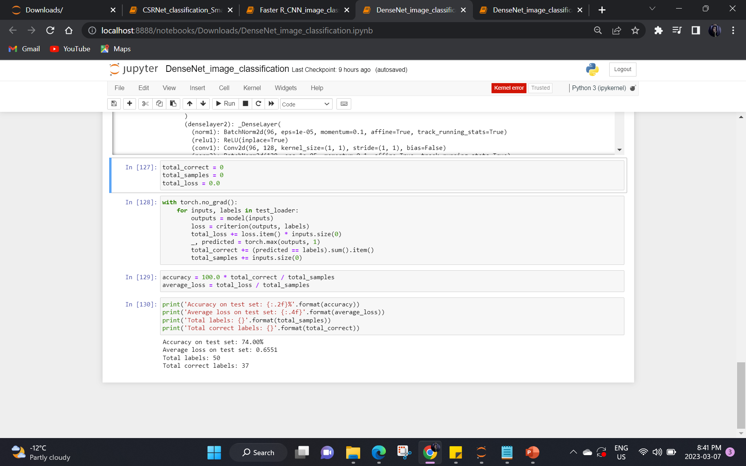
IMAGE CLASSIFICATION -- Model Comparison
CSRNet
DenseNet

Slide 14
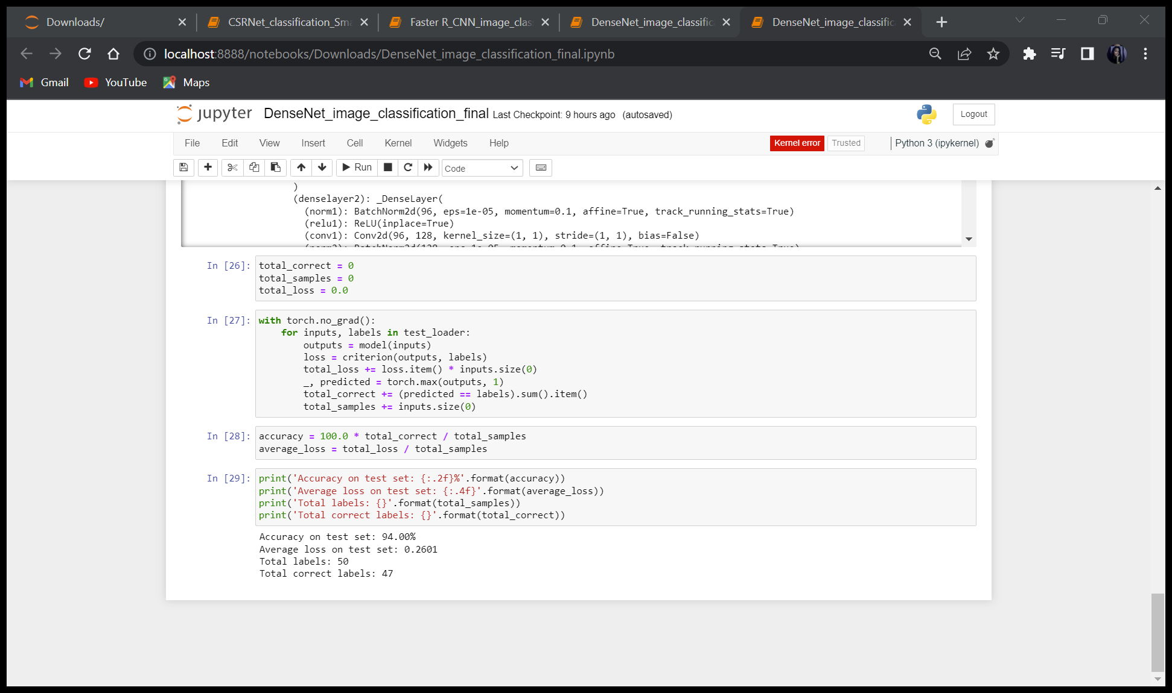
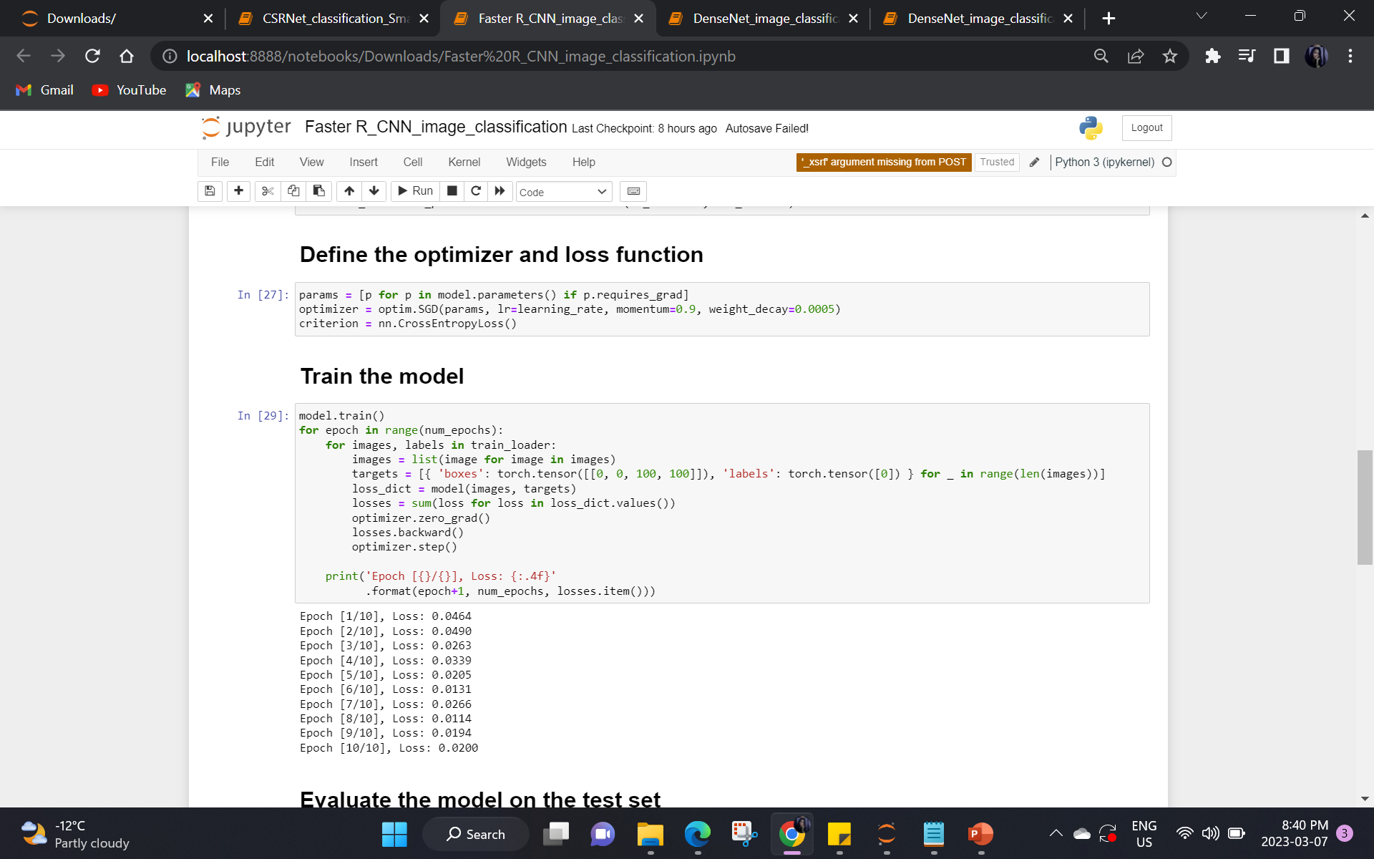
IMAGE CLASSIFICATION -- MODEL COMPARISON
DenseNet with 50 epoch
Faster RCNN

Slide 15
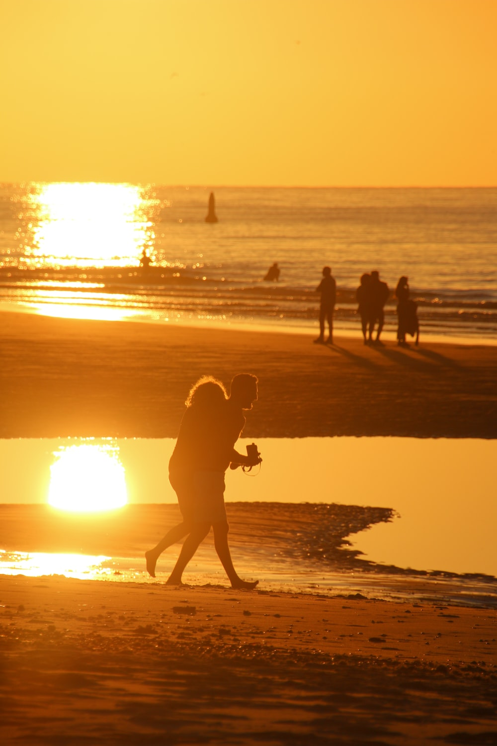
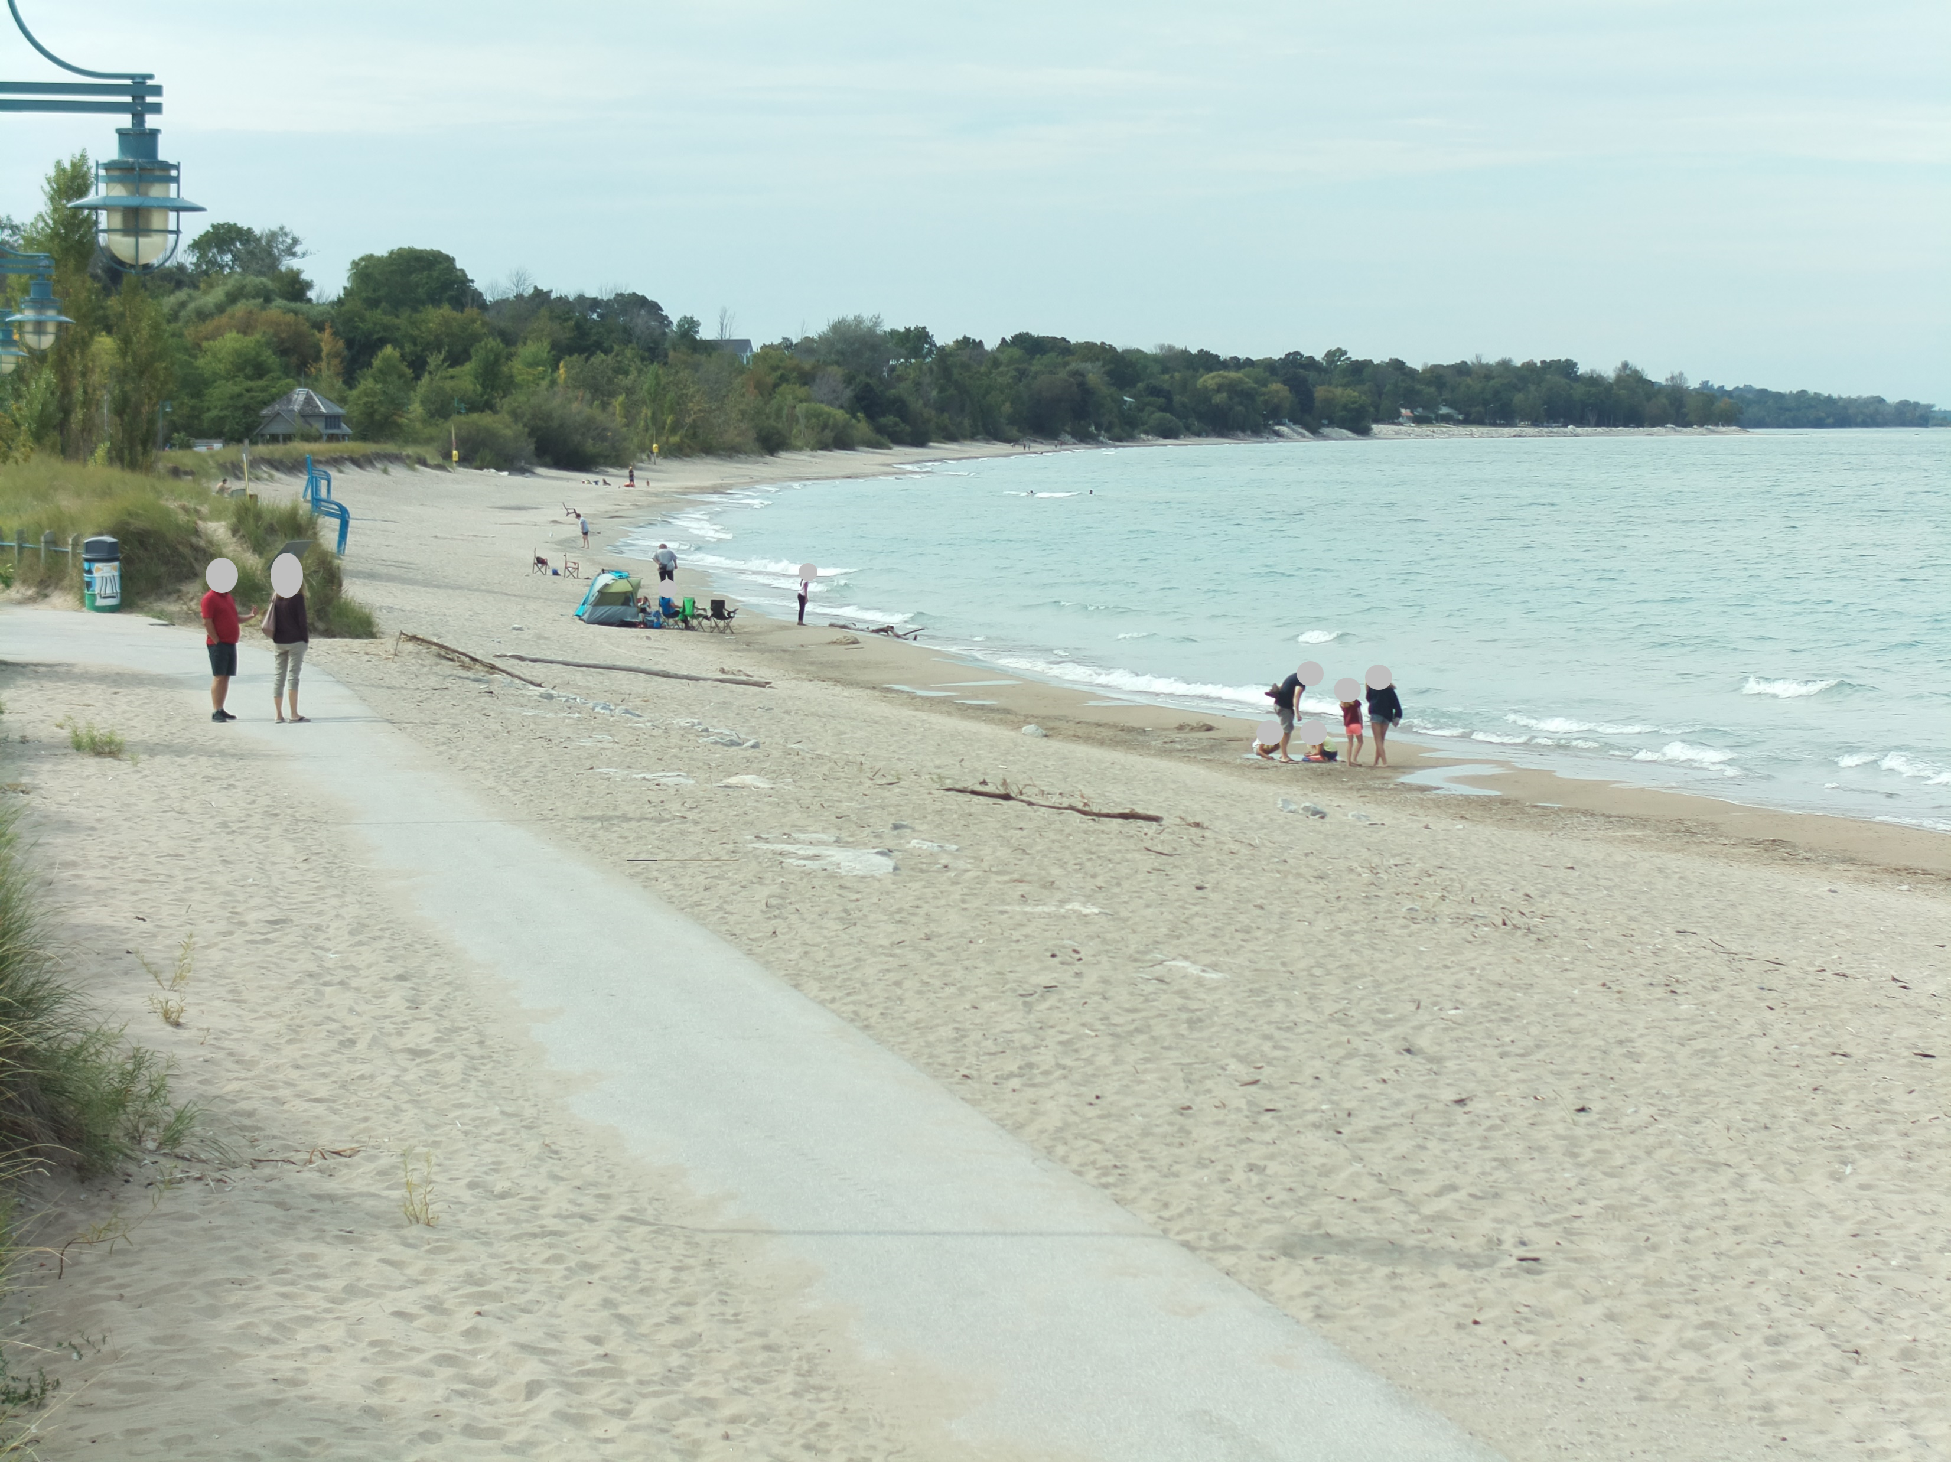
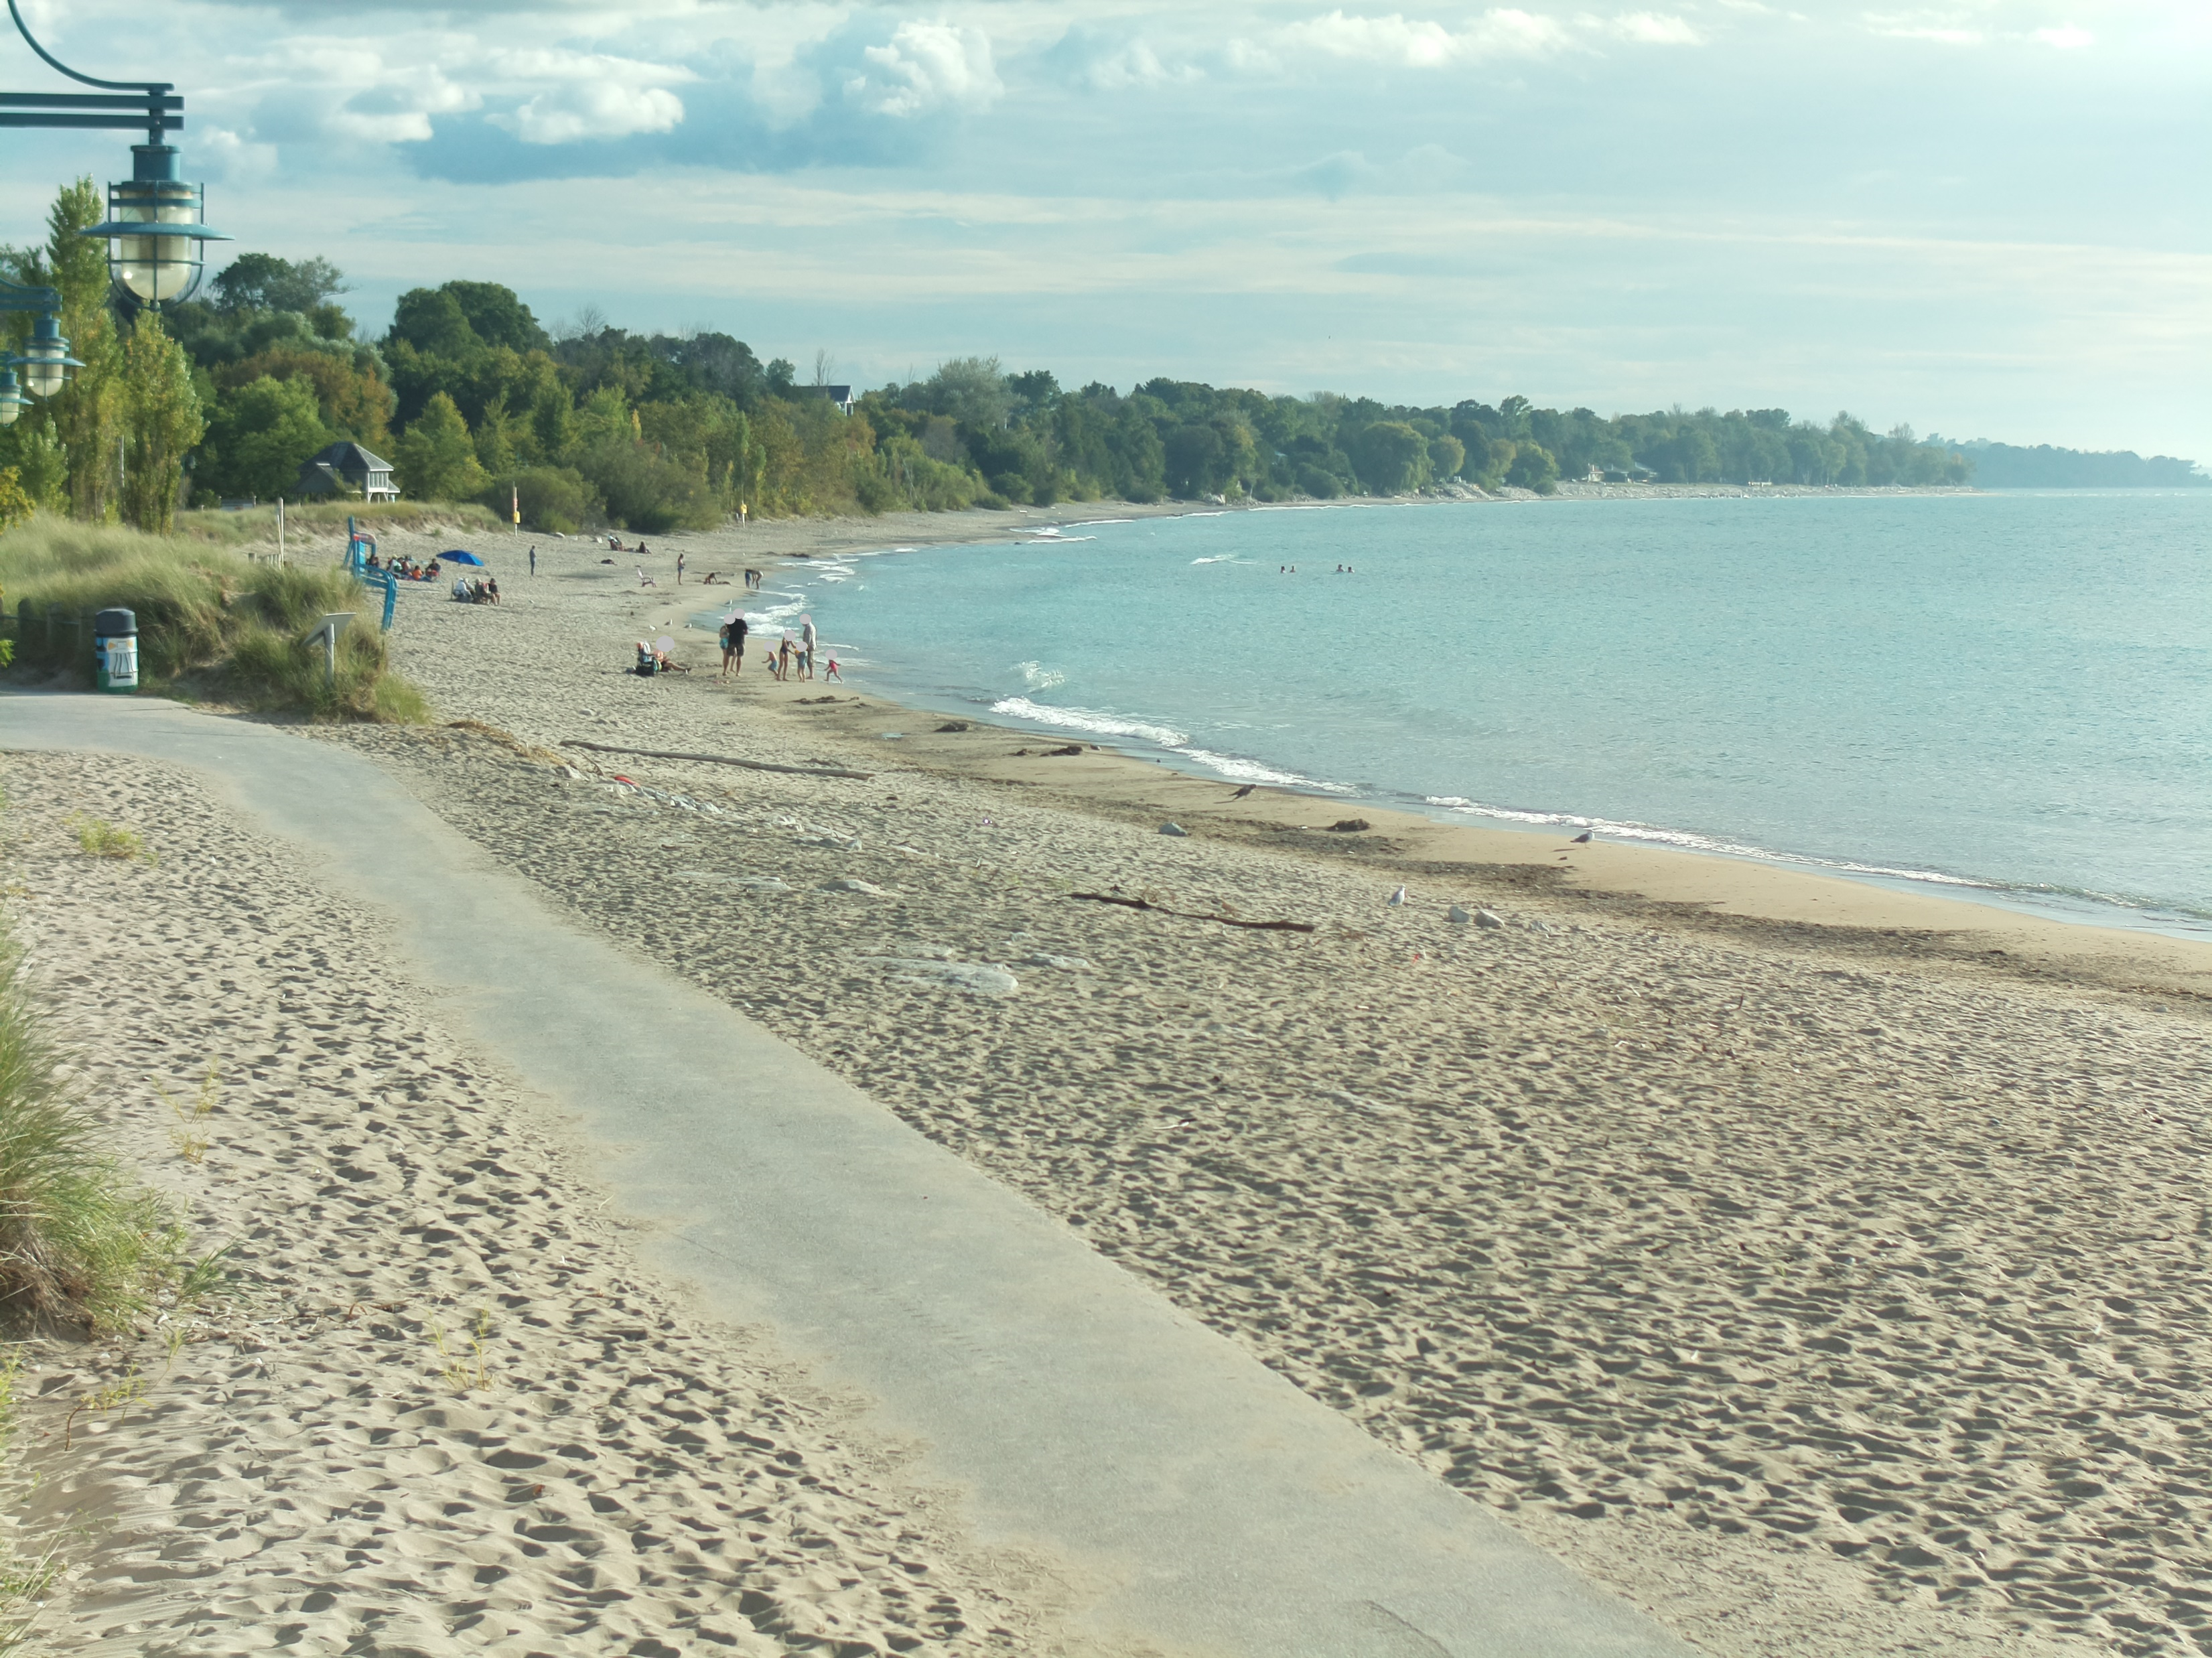
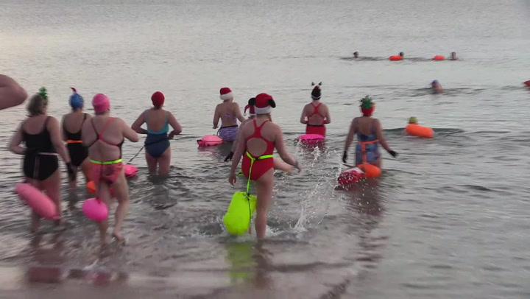
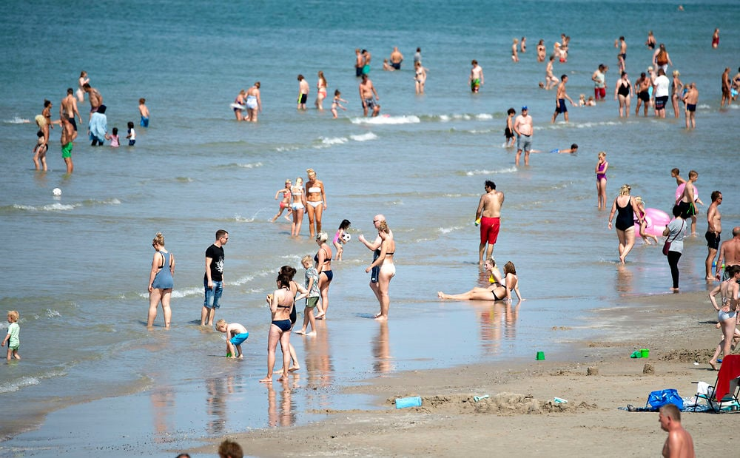
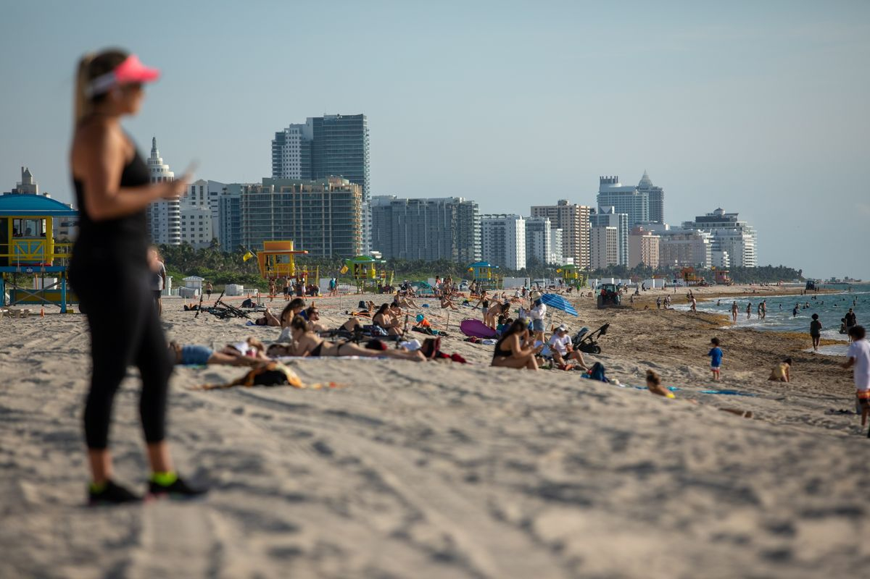
Image Classification -- results
Class : 0​
Class : 1
Class : 2
Bruce Beach(n.d.)
Bruce Beach(n.d.)
Steven(2021)
Jayme(2020.6)

Slide 16
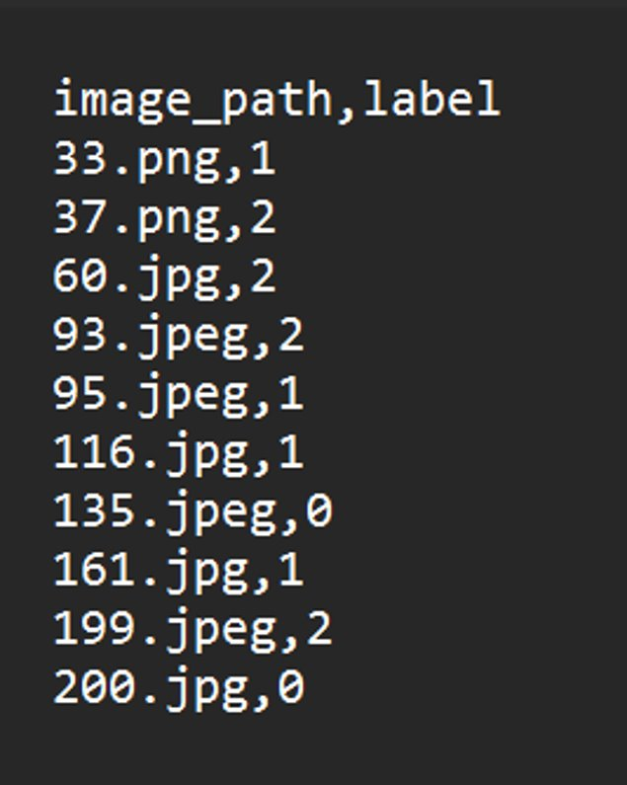
Image Classification -- result
As we can see here the model provides a CSV file including the predicted labels and image file name.

Slide 17
ComplexitY
CSRNet:
The CSRNet model has an average loss of around 248. Making the accuracy way lower.
DenseNet:
The DenseNet model with 10 epochs gave an accuracy of about 74%. After increasing the epoch count to 50 the accuracy increased drastically to 94%.
Faster R-CNN:
The RCNN model has the lowest average loss, even less than 0.05. Which will give the best output for classification. Also, RCNN will allow us to classify on the bases of the region as well.

Slide 18
Activities to be Completed before Next report
Testing RCNN model
Applying different crowd counting models on different classes and finalizing the models for each class
Final Testing of the architecture

Slide 19
Thank you!
Questions?
Notes:
Image: Leloo, The first (2022) https://www.pexels.com/photo/question-marks-on-paper-crafts-5428833/

